Slide 1
Placebo: Some Definitions
an inert substance given to a patient as if it were a drug in order to placate or to serve as a control in an experiment.
Placebo effects are the effects produced by placebos.
in the Roman Catholic Church, vespers for the dead. Placebo in Latin means “I shall please” and is the first word in these vespers.
By the 1300’s the term had become pejorative and suggested a sycophant. Probably linked to the singing of paid mourners who sang “placebos”.

Slide 2
Placebo: An expanded definition
Physically inert substances and medical procedures that are identical in appearance to an active pharmacological or (less commonly) other medical treatment being investigated.
Placebos can be active substances that mimic the side effects of the drug being investigated but do not possess the physical properties hypothesized to produce the beneficial treatment effect.
From Kirsch Prevention and Treatment V.5, article 22, 2002

Slide 3
Placebo history
A landmark study, in the 1950’s, by Henry Beecher of Harvard suggested that 30% to 40% of patients (for a wide range of afflictions) received relief from placebos.
Beecher, H.K. The Powerful Placebo. JAMA, 1955; 159:1602-6.

Slide 4
Evidence for the placebo effect
Asthmatic patients show bronchoconstriction after inhaling a placebo bronchoconstrictor and bronchodilation after inhaling a placebo bronchodilator.
Placebo morphine is more effective than placebo Darvon which is more effective than placebo aspirin.

Slide 5
Placebo evidence (cont)
Brand name placebos are more effective than generic placebos.
Placebo injections are more effective than placebo pills.
Higher doses of placebos produce a greater placebo response than lower doses of placebos.

Slide 6
Even Placebo Surgery!
A Controlled Trial of Arthroscopic Surgery for Osteoarthritis of the Knee. J. Bruce Moseley, M.D., Kimberly O'Malley, Ph.D., Nancy J. Petersen, Ph.D., Terri J. Menke, Ph.D., Baruch A. Brody, Ph.D., David H. Kuykendall, Ph.D., John C. Hollingsworth, Dr.P.H., Carol M. Ashton, M.D., M.P.H., and Nelda P. Wray, M.D., M.P.H.
N Engl J Med 2002; 347:81-88July 11, 2002
Is Placebo Surgery Unethical? Sam Horng, B.A., and Franklin G. Miller, Ph.D. N Engl J Med 2002; 347:137-139July 11, 2002

Slide 7
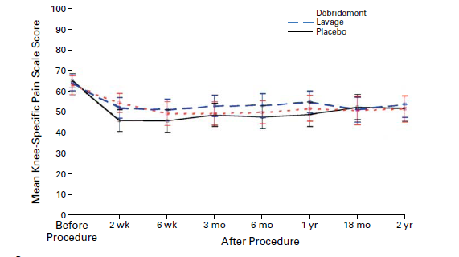
A Controlled Trial of Arthroscopic Surgery for Osteoarthritis of the Knee.
A total of 180 patients with osteoarthritis of
the knee were randomly assigned to receive arthroscopic débridement, arthroscopic lavage, or placebo surgery.
Results showed no difference in pain or functioning between the placebo group and the two surgery groups.

Slide 8
Does the placebo effect mean I only have to think about working out-to get a work out?
Mind-set matters: exercise and the placebo effect. Crum AJ, Langer EJ. Psychol Sci. 2007 Feb;18(2):165-71.
In a study testing whether the relationship
between exercise and health is moderated by one’s mindset,
84 female room attendants working in seven different hotels were measured on physiological health variables affected by exercise.
Those in the informed condition
were told that the work they do (cleaning hotel rooms) is
good exercise and satisfies the Surgeon General’s recommendations for an active lifestyle. Examples of how their
work was exercise were provided.
Subjects in the control
group were not given this information

Slide 9
Langer study Results.
Although actual behavior did not change, 4 weeks after the intervention, the informed group perceived themselves to be getting significantly more exercise than before. As a result, compared with the control group, they showed a decrease in weight, blood pressure, body fat, waist-to-hip ratio, and body mass index. These results support the hypothesis that exercise affects health in part or in whole via the placebo

Slide 10

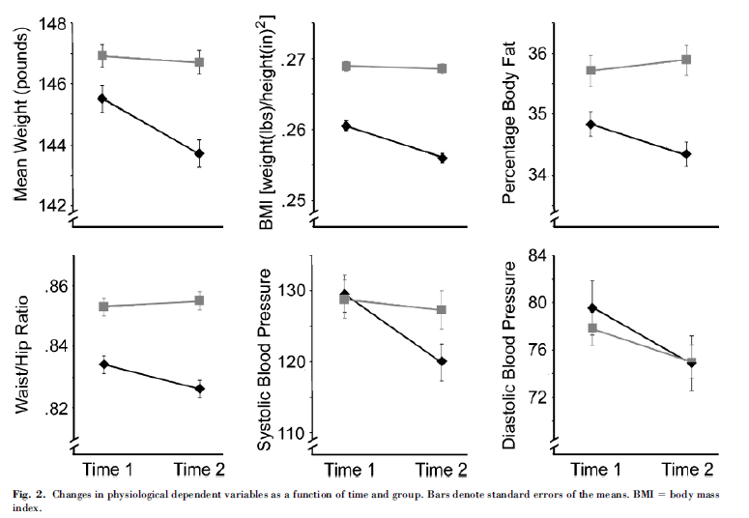

Slide 11
Does the placebo effect work even when we know it’s a placebo?
Placebos without deception: a randomized controlled trial in irritable bowel syndrome. Kaptchuk TJ, Friedlander E, Kelley JM, Sanchez MN, Kokkotou E, Singer JP, Kowalczykowski M, Miller FG, Kirsch I, Lembo AJ. PLoS One. 2010 Dec 22;5(12):e15591.
Two-group, randomized, controlled three week trial (August 2009-April 2010) conducted at a single academic center, involving 80 primarily female (70%) patients, mean age 47 ± 18 with IBS diagnosed by Rome III criteria and with a score ≥ 150 on the IBS Symptom Severity Scale (IBS-SSS). Patients were randomized to either open-label placebo pills presented as "placebo pills made of an inert substance, like sugar pills, that have been shown in clinical studies to produce significant improvement in IBS symptoms through mind-body self-healing processes" or no-treatment controls with the same quality of interaction with providers. The primary outcome was IBS Global Improvement Scale (IBS-GIS). Secondary measures were IBS Symptom Severity Scale (IBS-SSS), IBS Adequate Relief (IBS-AR) and IBS Quality of Life (IBS-QoL).

Slide 12
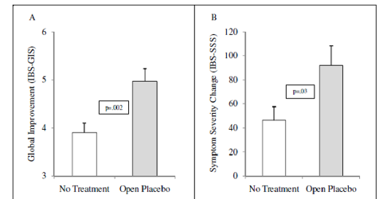
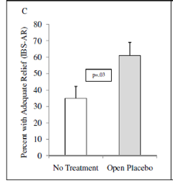
Apparently it does!
Open-label placebo produced significantly higher mean (±SD) global improvement scores (IBS-GIS) at both 11-day midpoint (5.2 ± 1.0 vs. 4.0 ± 1.1, p<.001) and at 21-day endpoint (5.0 ± 1.5 vs. 3.9 ± 1.3, p = .002). Significant results were also observed at both time points for reduced symptom severity (IBS-SSS, p = .008 and p = .03) and adequate relief (IBS-AR, p = .02 and p = .03); and a trend favoring open-label placebo was observed for quality of life (IBS-QoL) at the 21-day endpoint (p = .08).

Slide 13
Placebos and Anti-depressants
30 years of placebo controlled trials show placebo response rates of 30% to 50% and drug response rates of 45% to 70%.
Drug-placebo differences range from 18% to 25%.

Slide 14
Are Anti-depressants effective?
What do we make of the small effect size for anti-depressants?
Is it all just about getting treated and the meds make no difference?
Are we a victim of thinking like “Gee this Drug Company pen is great! Their drugs must be great too!?”
Have we been scammed?

Slide 15
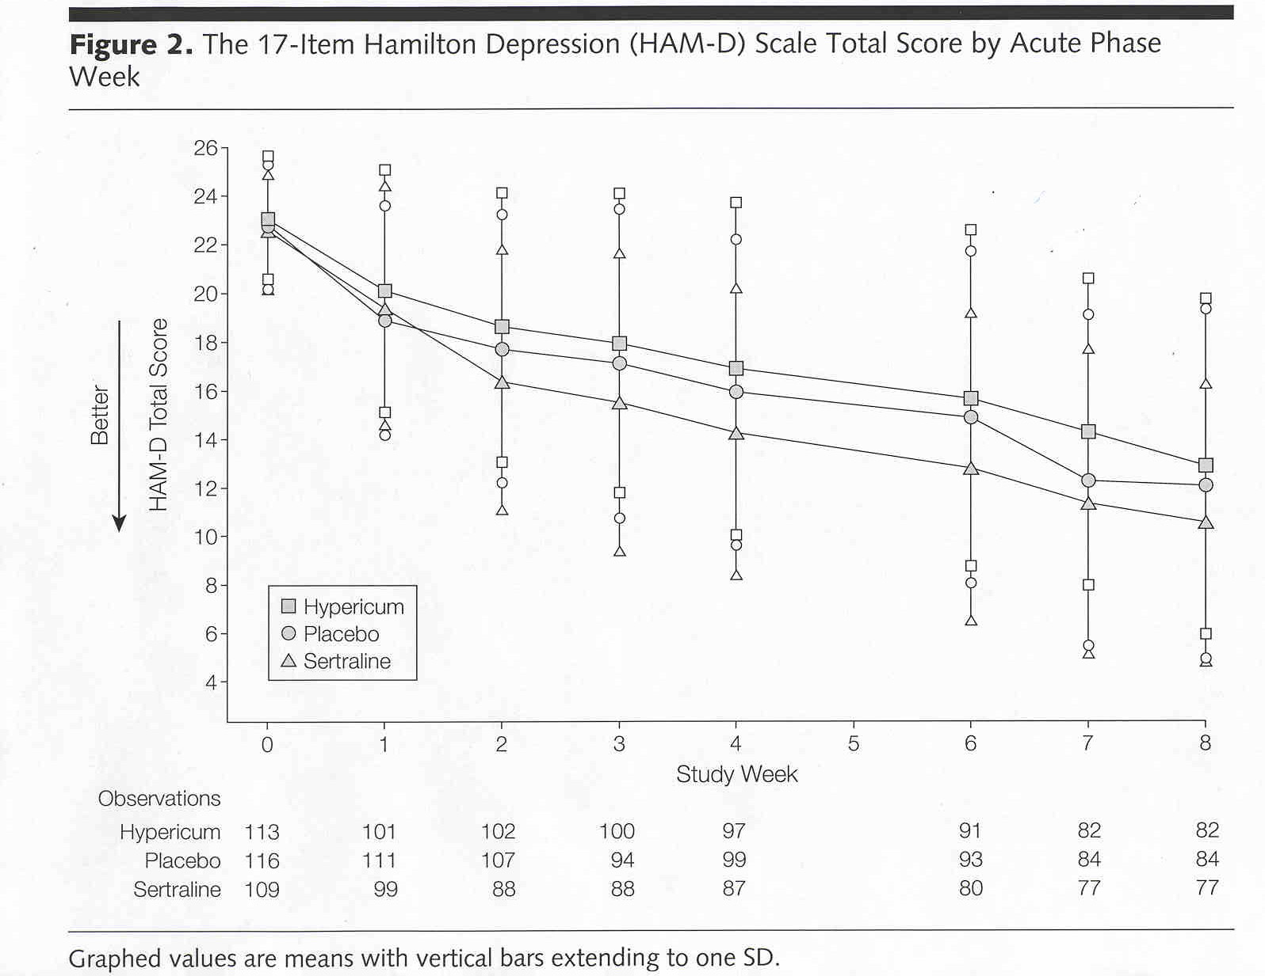
Effect of Hypericum perforatum (St John’s Wort) in Major Depressive Disorder. JAMA (2002) v.287(14):1807-1814.

Slide 16
What about the placebo effect?
Is it all in our heads?
Maybe…

Slide 17
Changes in Brain Function of Depressed Subjects During Treatment With Placebo
Leuchter et al. (Am J Psychiatry 2002; 159:122–129)
QEEG study double-blind placebo trial of SSRI’s.
Findings suggest that “effective” placebo treatment induces changes in brain function that are distinct from those associated with antidepressant medication.

Slide 18
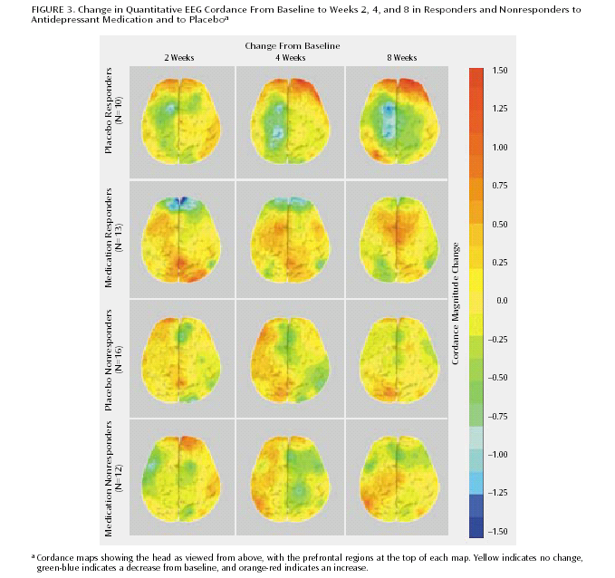

Slide 19
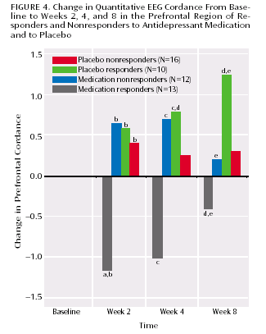

Slide 20
Are Placebo effects getting stronger?
Placebos Are Getting More Effective. Drugmakers Are Desperate to Know Why. Steve Silberman NY Times Magazine 08.24.09
Placebo response is all about the power of expectations. If we expect to feel better we will feel better. If we expect to feel worse, we will feel worse (Nocebo effect).

Slide 21
Has Big Pharma outsold itself?
15 years of pharmaceutical advertising has raised our expectations about pharmacological treatment.
These expectations involve the same higher cortical centers in the brain involved in many of the maladies that drug companies are attempting to treat.
By raising our expectations for treatment. Big Pharma may have increased placebo response itself. Drugs that once outperformed placebo no longer do.

